Slide 1
JF TECH
By Technical Support Team

Slide 2
H.265 DVR PLAYBACK
Common Playback
Sync Playback
Dayparting
Smart Express
Smart Search
Face Search

Slide 3
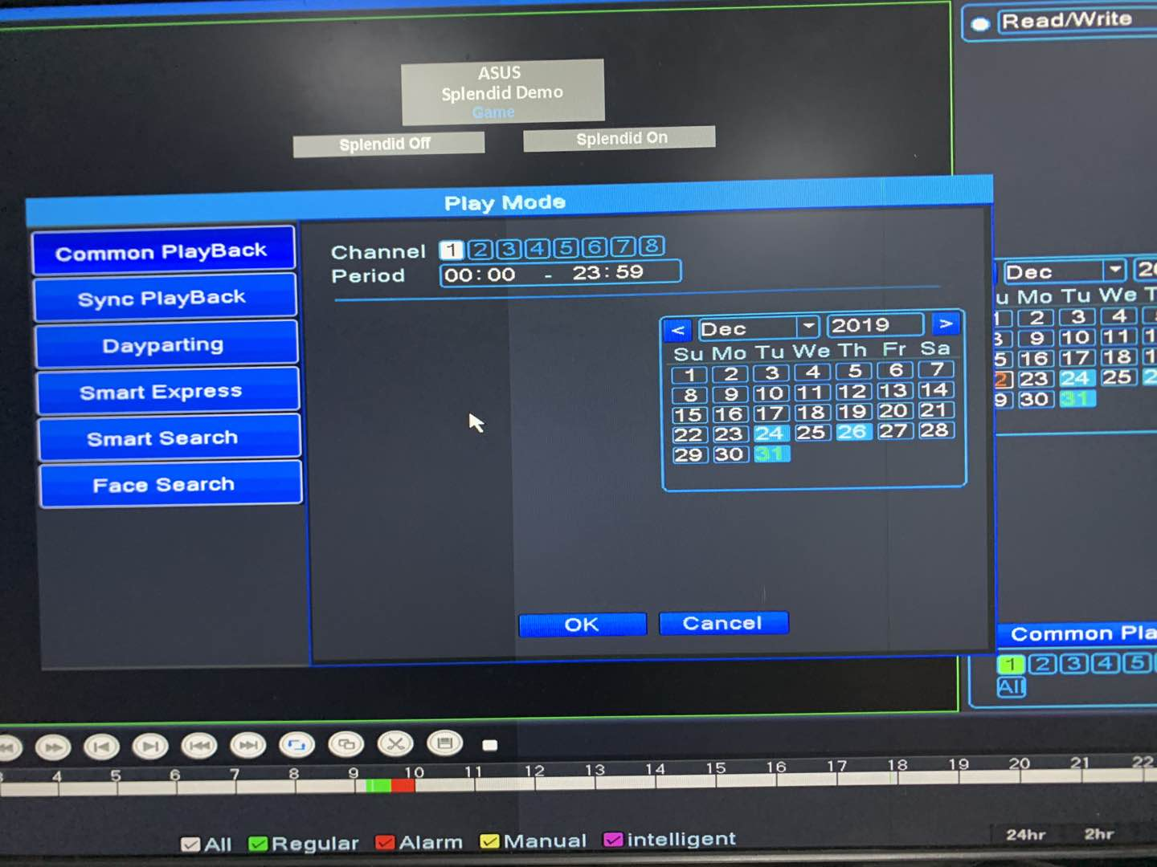
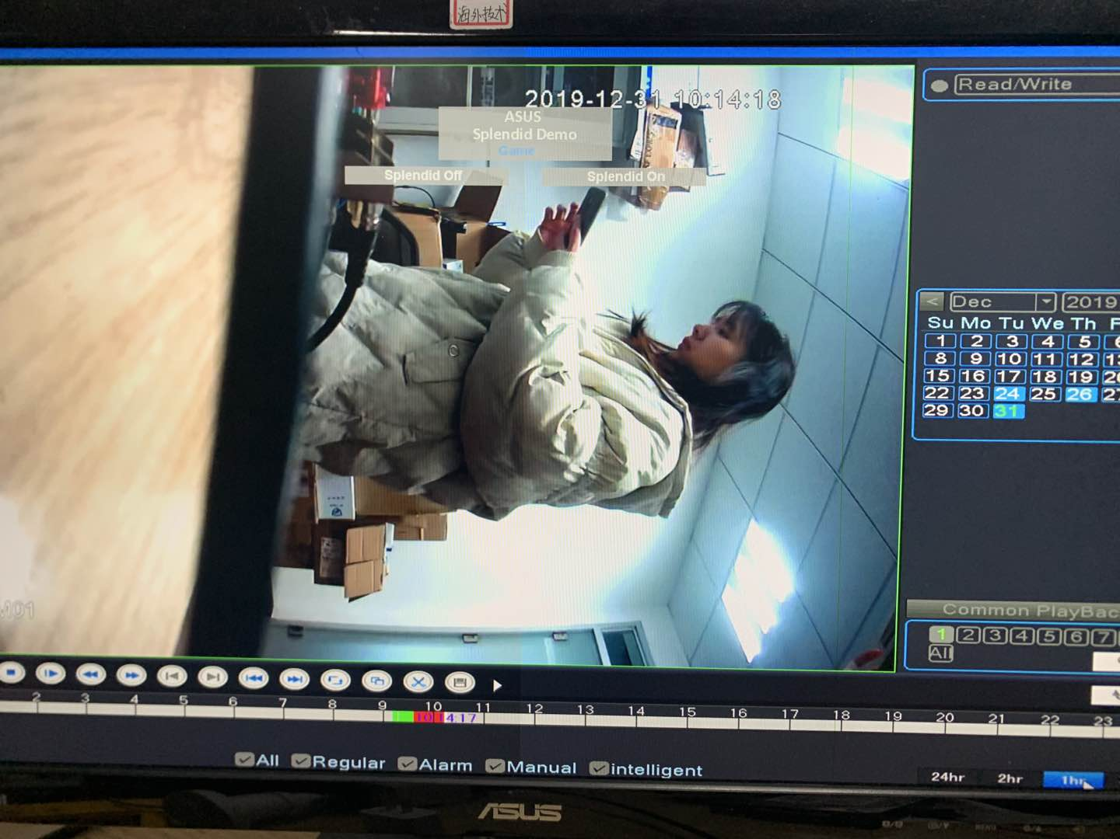
01
Common Playback
You can clearly carry out the regular video playback, select the corresponding channel ,date ,time period to play the regular video directly.

Slide 4
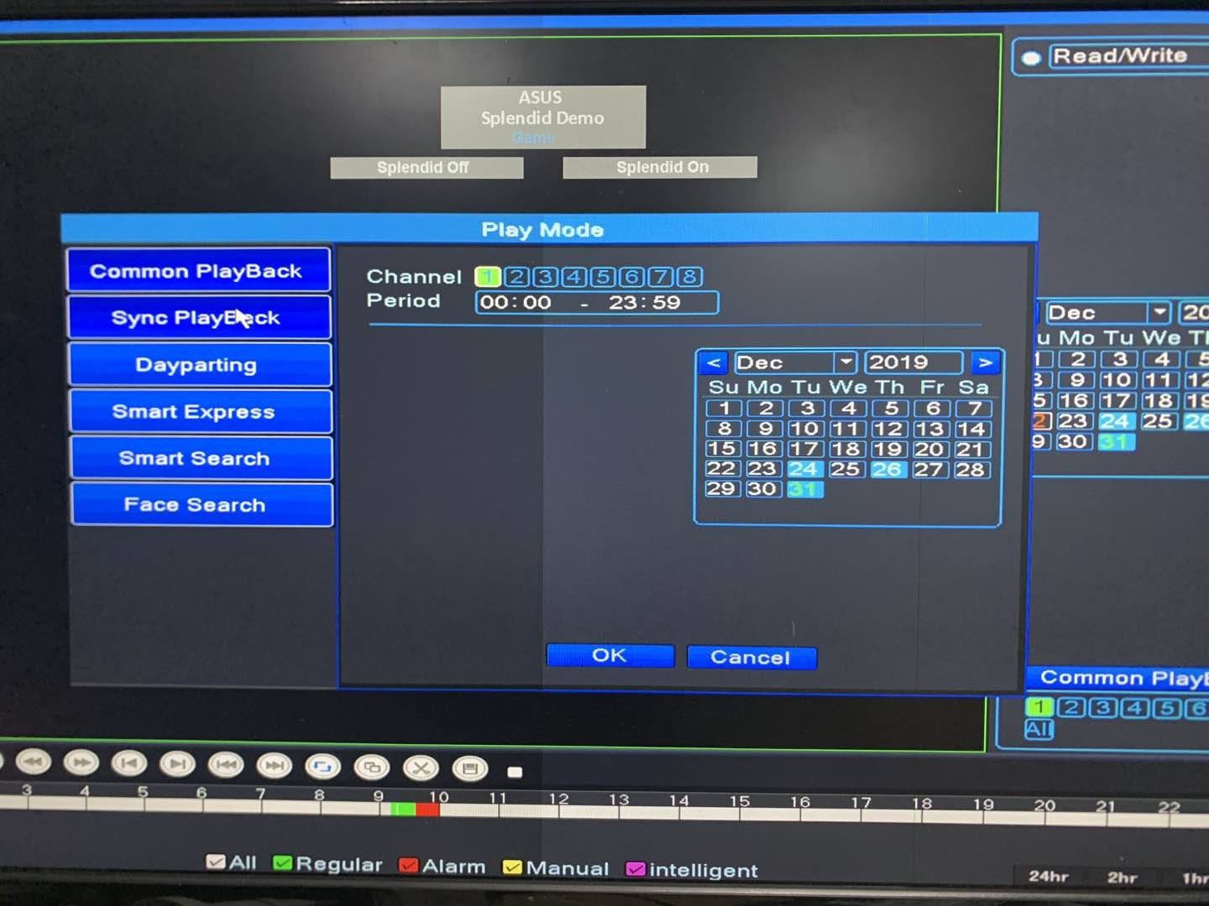
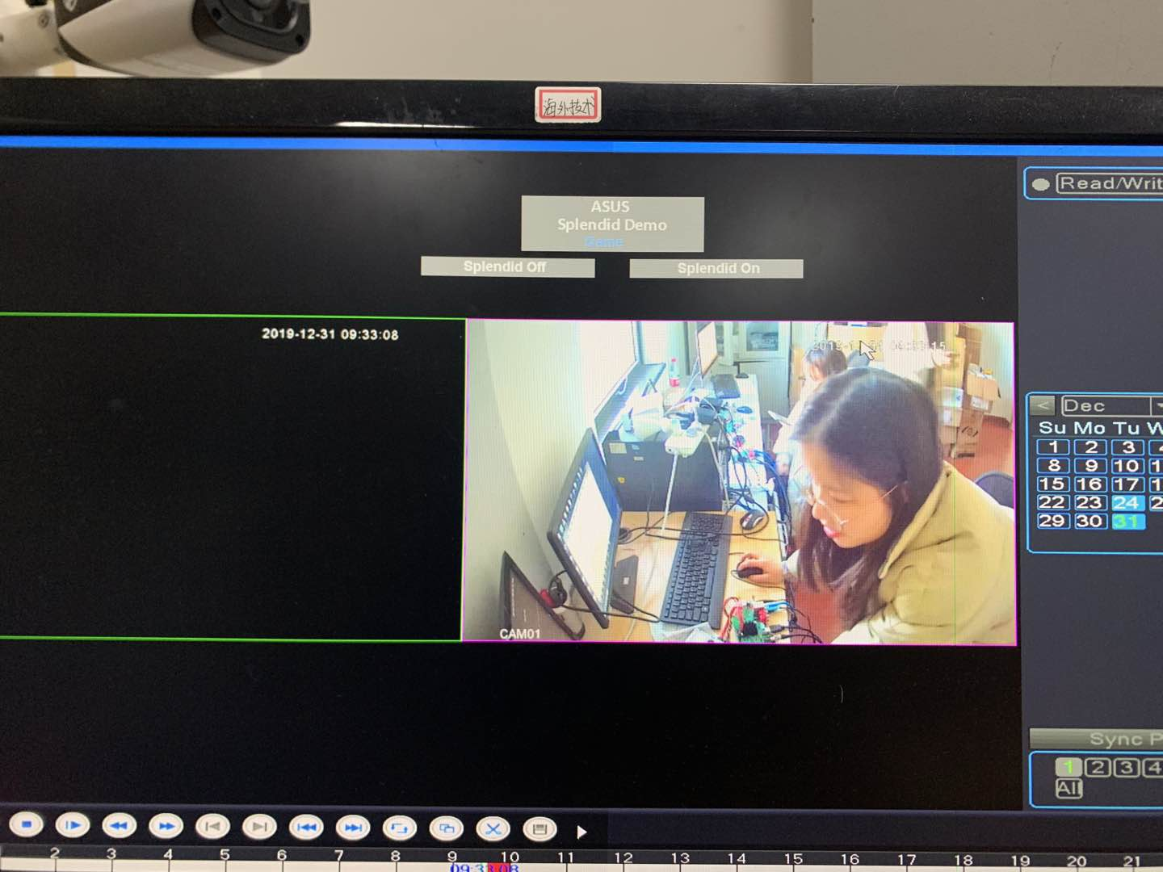
02
Sync PlayBack
Play back the video of each channel from the same time, select the corresponding channel, date and time period to enter the synchronous playback of these channels.

Slide 5
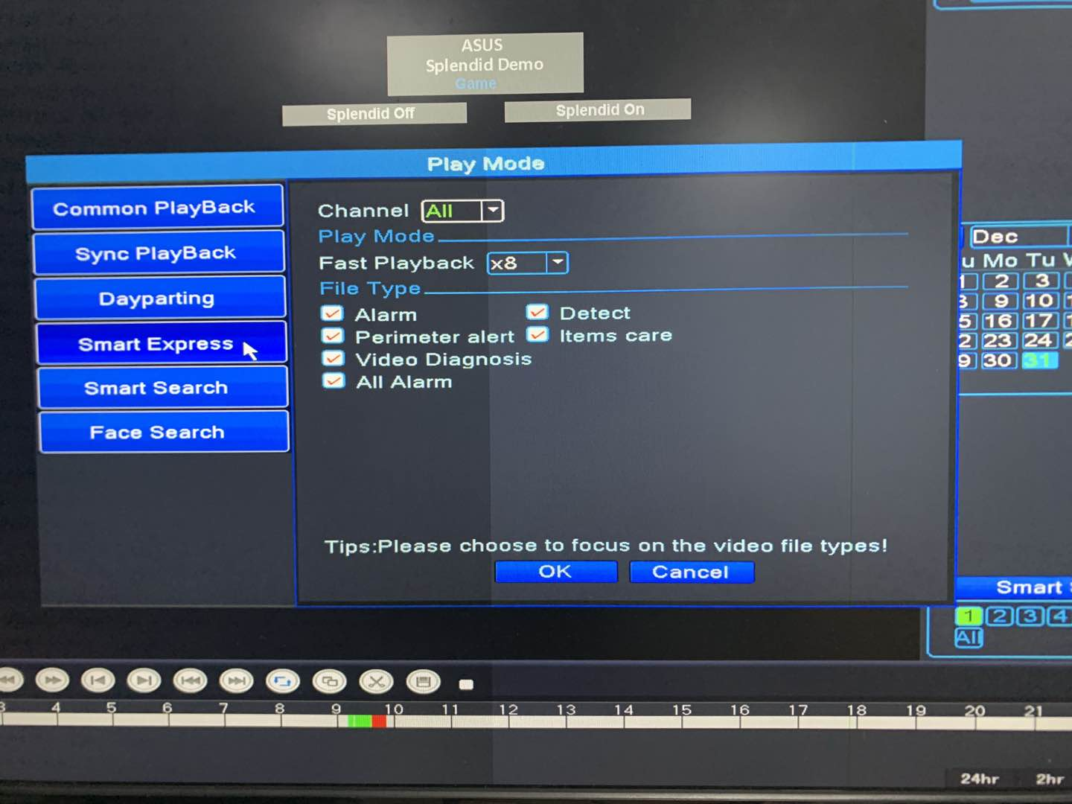
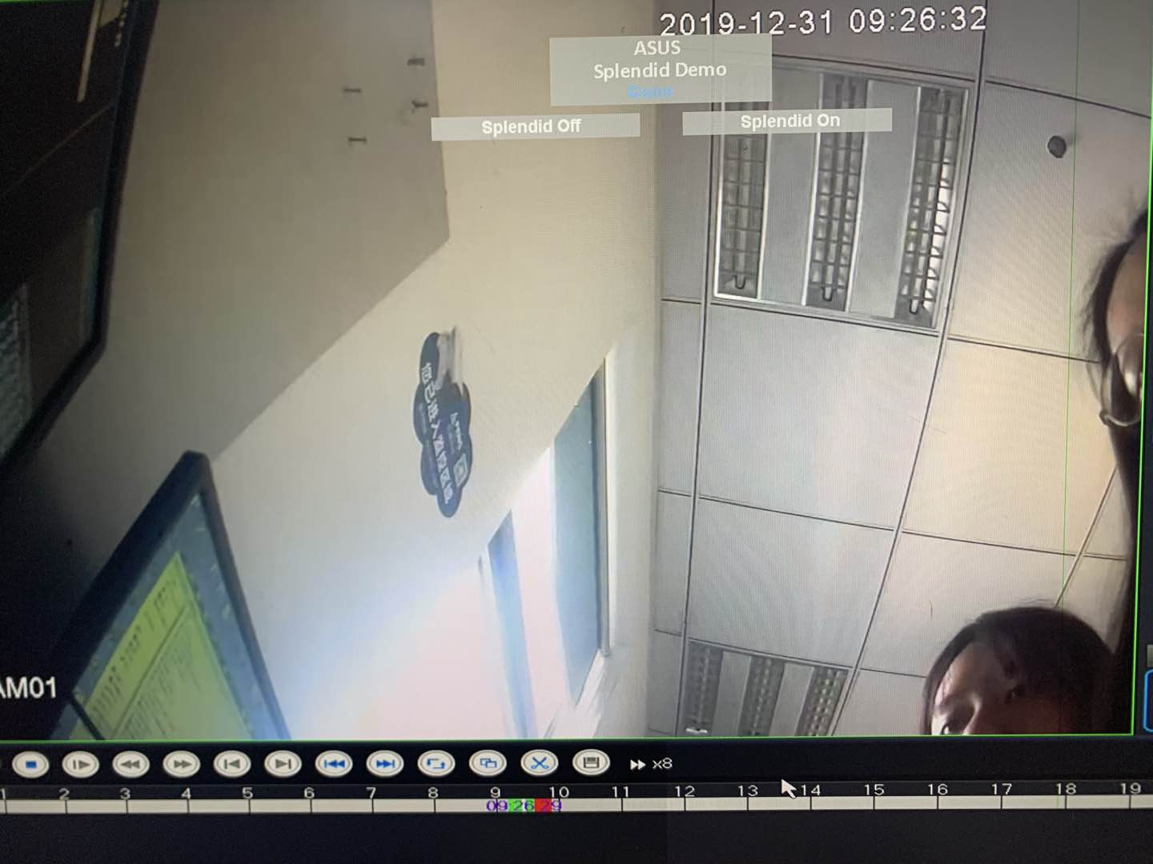
03
Smart Express
You can choose to play a playback video at a speed, select the appropriate channel, video type (alarm / detect/ perimeter alert/ items care / video diagnosis), and speed up the video you want to play back.

Slide 6
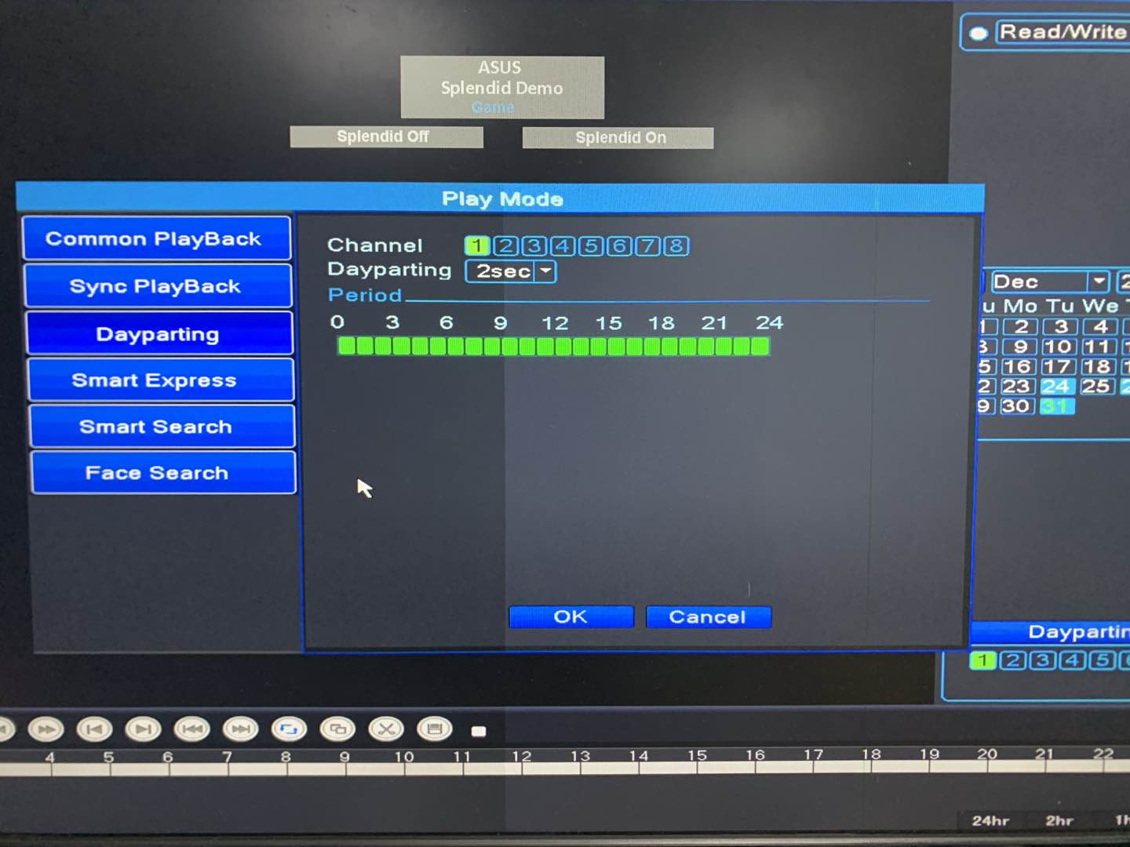
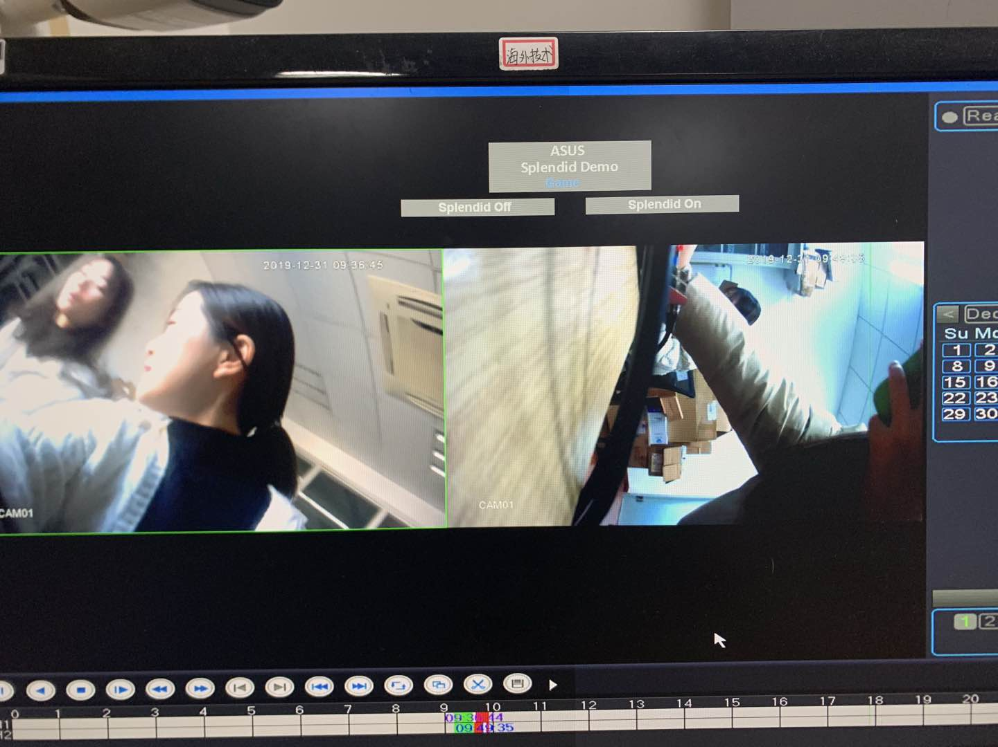
04
Dayparting
A video can be divided into several sections to quickly play, such as an hour of video, select 4 channels to play simultaneously,1 to 4 channels to play 0-15min/16-30min/31-45min/46-60min respectively. Select the corresponding channel, segment number, time period to enter the dayparting playback.

Slide 7
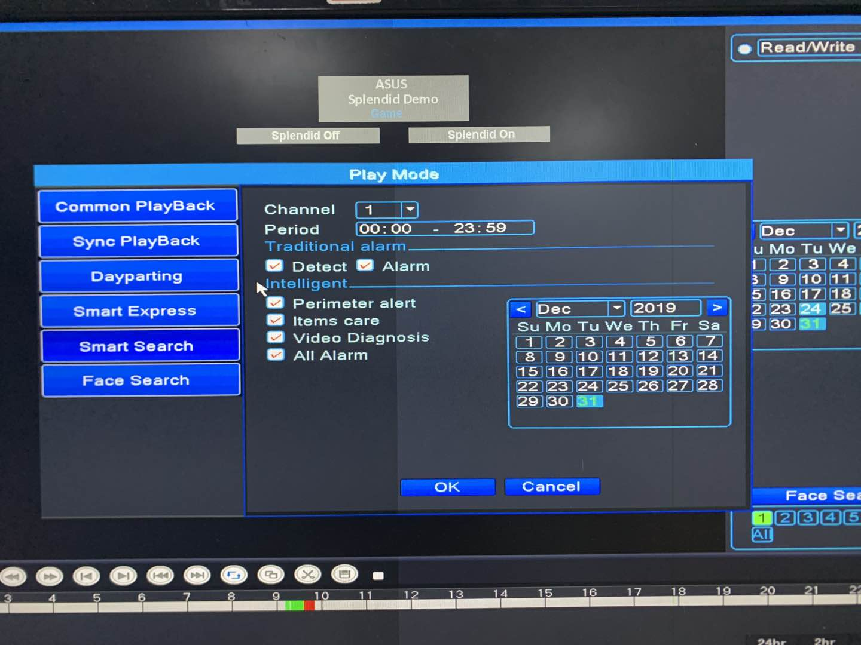
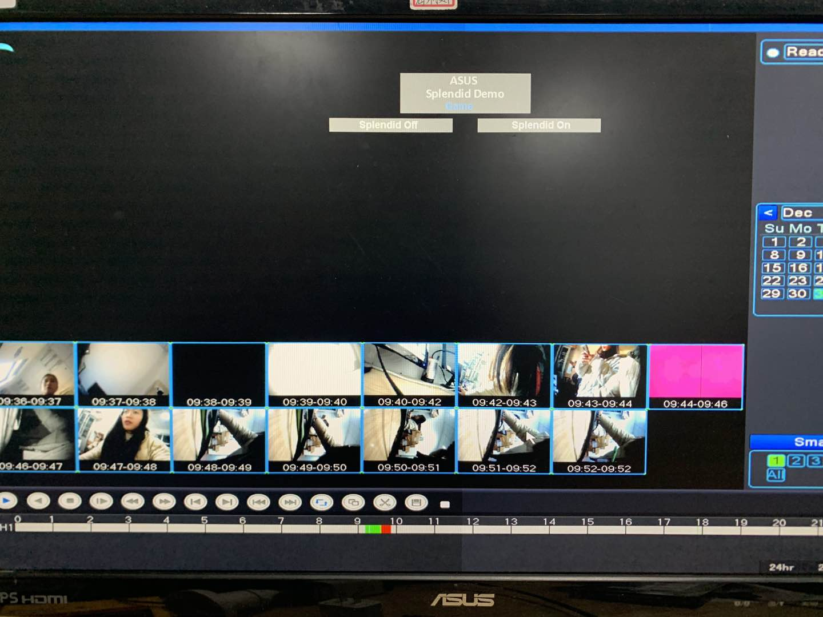
05
Smart Search
The video can be quickly accessed according to the corresponding video type (alarm / detect / perimeter alert/ items care / video diagnosis).

Slide 8
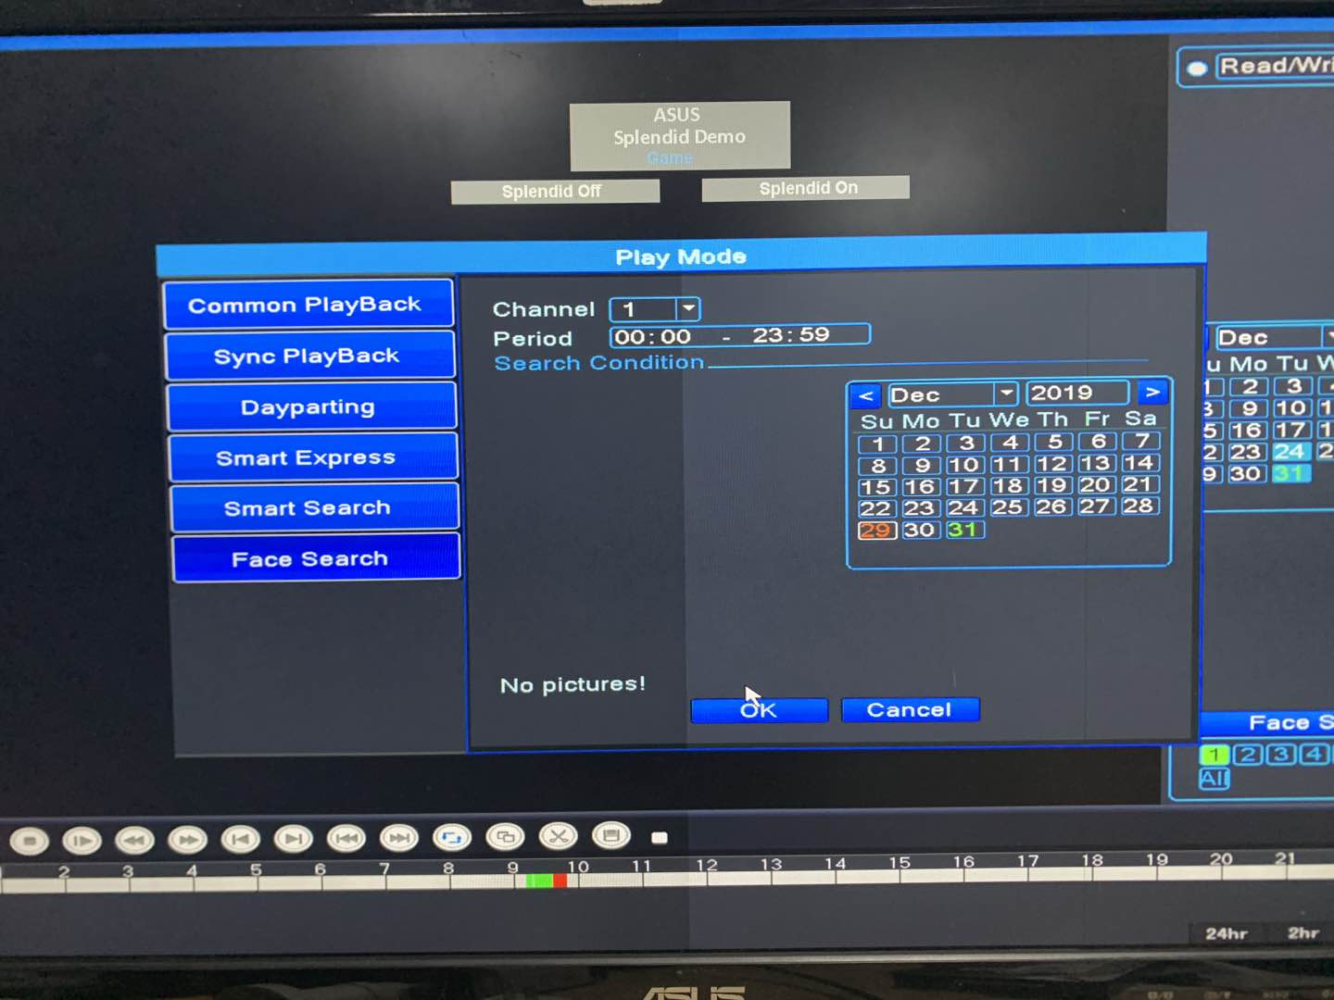
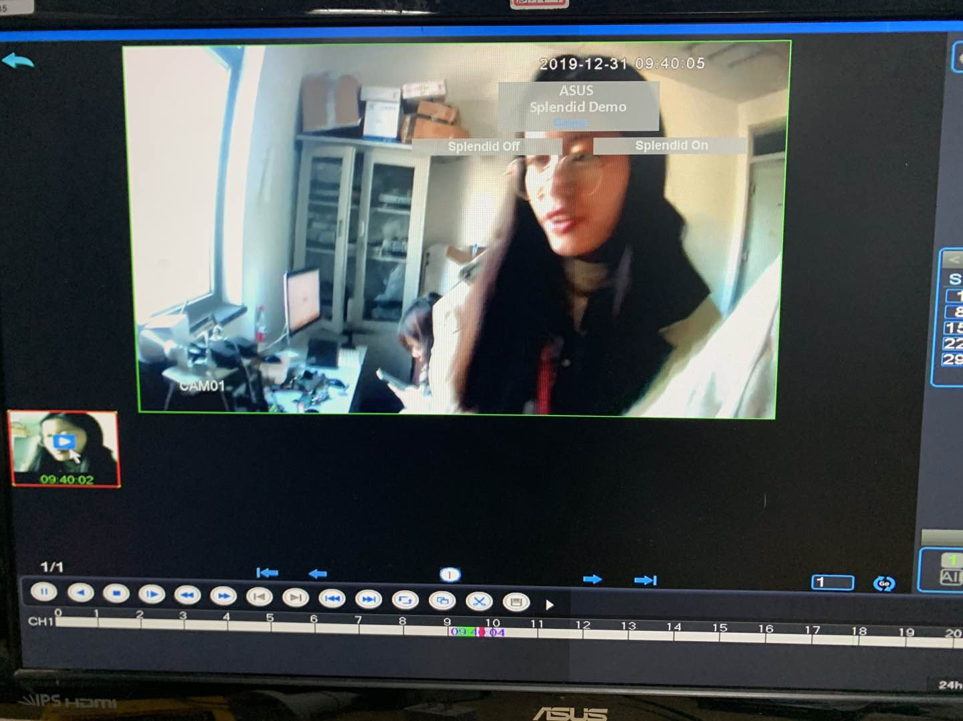
06
Face Search
The face in a playback video is retrieved and selectively played, and the corresponding channel, date and time period can be selected to quickly query the face Related video, play the video of the target character quickly and accurately .

Slide 9
THANKS

